Slide 1

Multiple Tests
Reading: 8.2
exercises: ch 8. 10, 13
Assigned: hw 10
Producer: dr. mario
img credit: alex riegert-waters

Slide 2


Pairwise Comparisons After ANOVA
Want to Test Hypotheses for Each $i$ and $j$ at the 5% Significance Level
Create Confidence Intervals for Each Unique $μ_{i}−μ_{j}$
Goal: Explore Different Options for Critical Values
$H_{0}:μ_{i}−μ_{j}=0$ vs $H_{a}:μ_{i}−μ_{j}≠0$
$${\overline{y}}_{i}−{\overline{y}}_{j}±cv\sqrt{MSE\left(\frac{1}{n_{i}}+\frac{1}{n_{j}}\right)}$$
cv = “Critical Value”
Controls Width and Based Off Significance Level

Slide 3

Pairwise Comparisons After ANOVA
95% Confidence Interval for $μ_{i}−μ_{j}$
Interpretation: Method results in a confidence interval that contains the true $μ_{i}−μ_{j}$ in 95% of cases if repeated infinite times.
Conclusion: 5% of the infinite cases will result in confidence intervals that do not contain the true $μ_{i}−μ_{j}$
More Confidence Intervals -> Chance of Getting an Interval that Doesn’t Contain the True $μ_{i}−μ_{j}$ Increases (Familywise Error Rate)

Slide 4
Example: Grades on Different Exams
Five Students (Barb, Betsy, Bill, Bob, Bud) Take Four Exams (1, 2, 3, 4)
Question: For each pair of students, is there a significant difference in the average grade for the two students?
There are 10 Questions Here Because There are 10 Unique Pairs
Familywise Error Rate if We Create 10 Different 95% CI’s
$$1−{0.95}^{10}=40\%$$

Slide 5

Fisher’s LSD
Liberal Approach
Small Critical Values -> Narrow Intervals
More Likely to Claim that a Difference Exists
Method:
Step 1: Verify ANOVA F-test is Significant
Step 2: Compute All Intervals
$${\overline{y}}_{i}−{\overline{y}}_{j}±t_{0.975,n−K}\sqrt{MSE\left(\frac{1}{n_{i}}+\frac{1}{n_{j}}\right)}$$

Slide 6
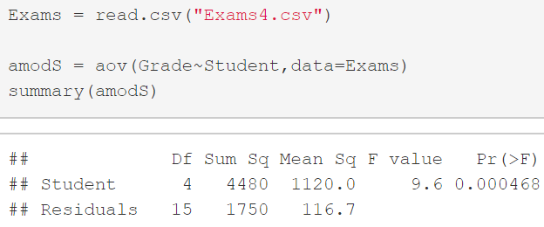
Example: Grades on Different Exams
ANOVA Model and Output
Step 1 of Fisher’s LSD
Achieved Significance!!

Slide 7
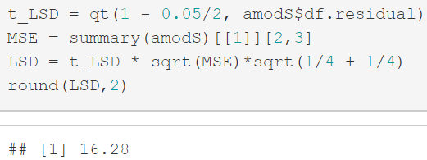
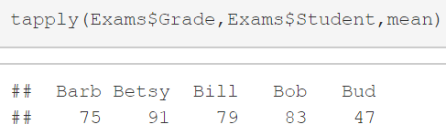
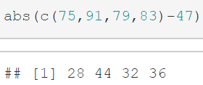
Example: Grades on Different Exams
Margin of Error the Same for Every Pair
Sample Means of 5 Students
Difference Between Bud and Each Other Student is More Than 16.28

Slide 8
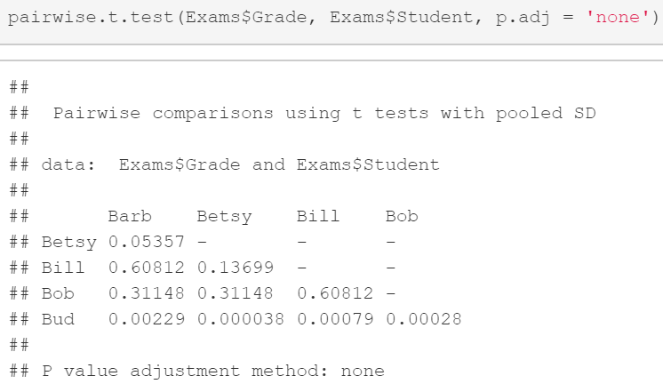
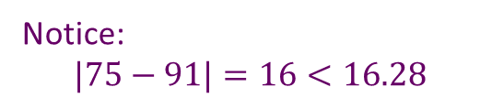
Example: Grades on Different Exams
All Pairwise t-Tests Under Fisher’s LSD
Notice:
$$|75−91|=16<16.28$$
Agreement with Previous Slide

Slide 9


Bonferroni Adjustment
Conservative Approach -> Decrease $α$ for Each CI -> Wider Intervals
Method:
Step 1: Choose a Familywise Error Rate $α^{∗}$
Step 2: Decide How Many Intervals You are Computing. This is $m$.
Step 3: Individual Error Rate for Each CI is $α=\frac{α^{∗}}{m}$
Step 4: Compute Intervals
99.99999%
99%
95%
0
$${\overline{y}}_{i}−{\overline{y}}_{j}±t_{1−\frac{α}{2},n−K}\sqrt{MSE\left(\frac{1}{n_{i}}+\frac{1}{n_{j}}\right)}$$

Slide 10
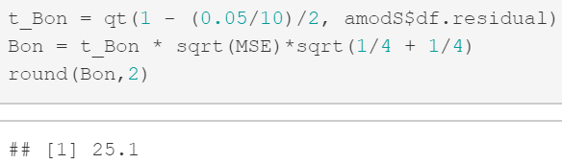
Example: Grades on Different Exams
Margin of Error the Same for Every Pair
Sample Means of 5 Students
Difference Between Bud and Each Other Student is More Than 25.1

Slide 11
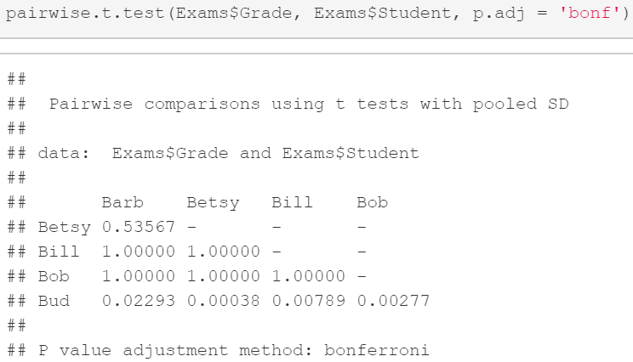
Example: Grades on Different Exams
All Pairwise t-Tests Under Bonferroni Adjustment
Still All Less Than 0.05

Slide 12


Tukey’s HSD
Moderate Approach
Method:
Step 1: Choose a Familywise Error Rate $α^{∗}$
Step 2: Find Value of $q$ from the Studentized Range Distribution Based on $α^{∗}$, number of groups $K$, and $n−K$ d.f.
Step 4: Compute Intervals
$${\overline{y}}_{i}−{\overline{y}}_{j}±\frac{q}{\sqrt{2}}\sqrt{MSE\left(\frac{1}{n_{i}}+\frac{1}{n_{j}}\right)}$$

Slide 13
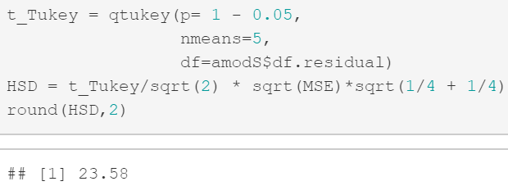
Example: Grades on Different Exams
Margin of Error the Same for Every Pair
Notice:
$$Fisher^{′}s LSD<Tukey^{′}s HSD<Bonferroni$$
$$16.28<23.58<25.1$$

Slide 14
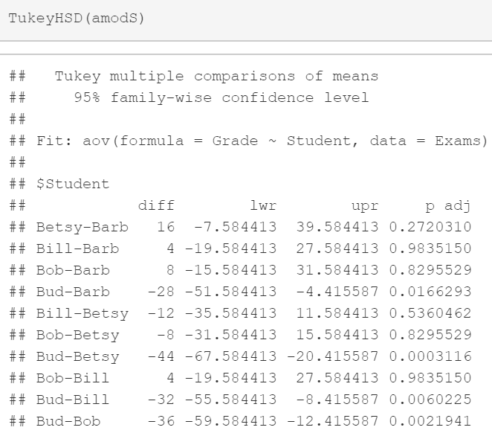
Example: Grades on Different Exams
All Pairwise t-Tests Under TukeyHSD
The Fourth Column Shows P-values
Only Find Significance With Bud

Slide 15
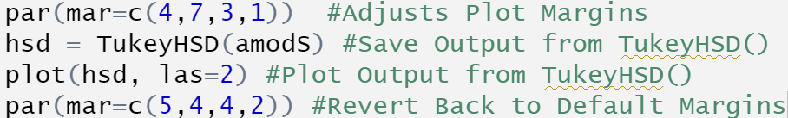
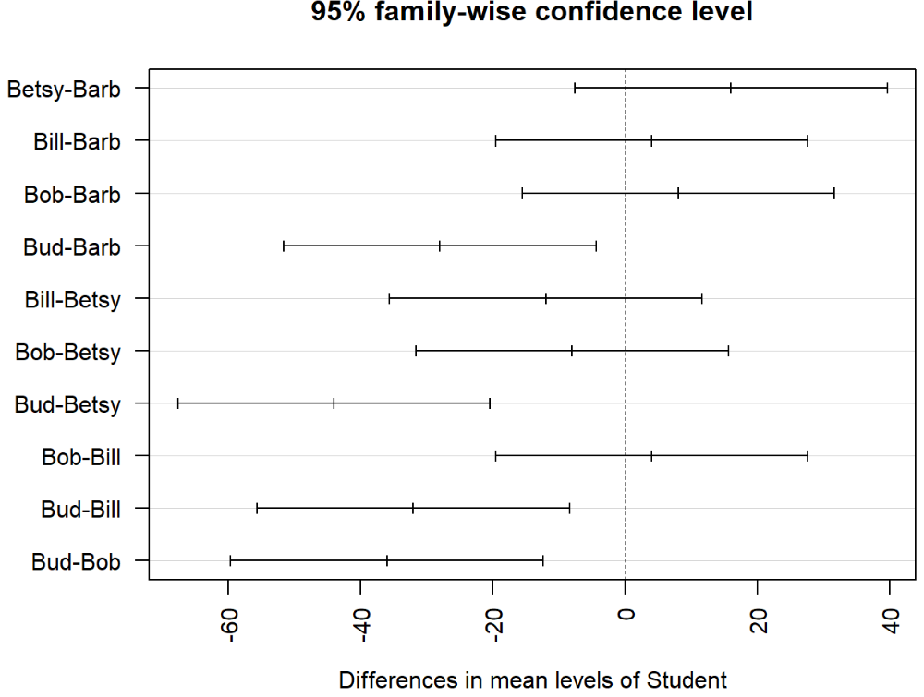
Example: Grades on Different Exams
Plot of Confidence Intervals Using Tukey’s HSD
Calculation for Betsy vs Barb
$$(16−23.58, 16+23.58)$$
$$(−7.58, 39.58)$$

Slide 16
Thank You
Make Reasonable Decisions

